Slide 1







Amazon Bestselling Books – Analysis & Insights
Guided by: Gitanjali Ma’am
TEAM:
Aditya Nanda
Aniket Routray
Raghupati Sahoo

Slide 2
Introduction
Amazon is the world’s largest online book retailer, offering millions of titles across a wide range of genres. The Amazon Top Selling Books list highlights the most purchased and highly rated titles within a given period, reflecting current reader interests and literary trends. These rankings provide valuable insights into reading habits, consumer preferences, and publishing success. The purpose of this study is to analyze the Amazon Top Selling Books dataset, examining patterns in genres, pricing, ratings, and author performance to uncover meaningful takeaways and actionable insights.

Slide 3

Project Overview – Data Analysis of Amazon’s Top Selling Books
Objective:
Analyze Amazon’s Top Selling Books using modern data analytics & machine learning to uncover patterns and make predictions.
Dataset Includes:
Title, Author, Genre, Rating, Reviews, Price
Tools Used:
Excel, Power BI, Tableau, Python
Approaches:
Manual Spreadsheet Analysis – Filters, pivot tables, charts
Dashboards – Interactive insights with Power BI,Tableau and Excel.
Statistical & EDA – Pandas, Matplotlib, Seaborn
Predictive Modeling – Logistic Regression, Naive Bayes, KNN, SVM
Data Preprocessing – Encoding, scaling, dataset splitting
Outcome:
Deliver actionable insights & predictions to aid publishers, sellers, and marketers in forecasting and strategic planning.

Slide 4
WHAT ARE AMAZON BESTSELLING BOOKS?
Amazon Bestselling Books are ranked based on their overall sales performance in the Amazon marketplace.
These rankings are updated hourly, taking into account both recent purchases and historical sales trends.
The list features titles from both Fiction and Non-Fiction categories, covering a wide range of reader interests.
Selections are often influenced by pop culture movements, media coverage, and the popularity of authors.

Slide 5
CATEGORIES OF AMAZON BESTSELLERS
Based on our dataset:
Fiction – Creative storytelling works such as novels, classics, thrillers, and other narrative-driven literature.
Non-Fiction – Informative works including self-help, biographies, history, educational material, and factual content.
Count in Dataset:
Fiction: 240 titles
Non-Fiction: 310 titles

Slide 6
TOP 5 AMAZON BESTSELLING BOOKS
10-Day Green Smoothie Cleanse – JJ Smith
Rating: 4.7 ★ | Reviews: 17,350 | Price: $8 | Year: 2016 | Genre: Non-Fiction
2.11/22/63: A Novel – Stephen King
Rating: 4.6 ★ | Reviews: 2,052 | Price: $22 | Year: 2011 | Genre: Fiction
3.12 Rules for Life: An Antidote to Chaos – Jordan B. Peterson
Rating: 4.7 ★ | Reviews: 18,979 | Price: $15 | Year: 2018 | Genre: Non-Fiction
4.1984 (Signet Classics) – George Orwell
Rating: 4.7 ★ | Reviews: 21,424 | Price: $6 | Year: 2017 | Genre: Fiction
5.5,000 Awesome Facts – National Geographic Kids
Rating: 4.8 ★ | Reviews: 7,665 | Price: $12 | Year: 2019 | Genre: Non-Fiction

Slide 7
INSIGHTS & TRENDS FROM DATA
Highest User Rating: 4.9 ★
Lowest User Rating: 4.5 ★
Price Range: $3 – $105
Most Common Genre: Non-Fiction
Most Recent Publication Year: 2020
Oldest Publication Year: 2011
Authors with Multiple Entries: Several bestselling authors appear more than once.

Slide 8
ADVANTAGES OF BESTSELLER LISTS:
Reader Guidance: Helps customers quickly find popular, trusted titles.
Author Recognition: Increases exposure and credibility.
Sales Boost: Bestseller tag drives further purchases.
Trend Indicator: Shows current cultural and literary trends.

Slide 9
DISADVANTAGES OF BESTSELLER LISTS:
Popularity Over Quality: Not all bestsellers are critically acclaimed.
Short-Term Trends: Some books rise due to temporary hype.
Genre Bias: Certain genres dominate, limiting diversity.
Manipulation Risks: Bulk purchases can artificially boost rankings.

Slide 10
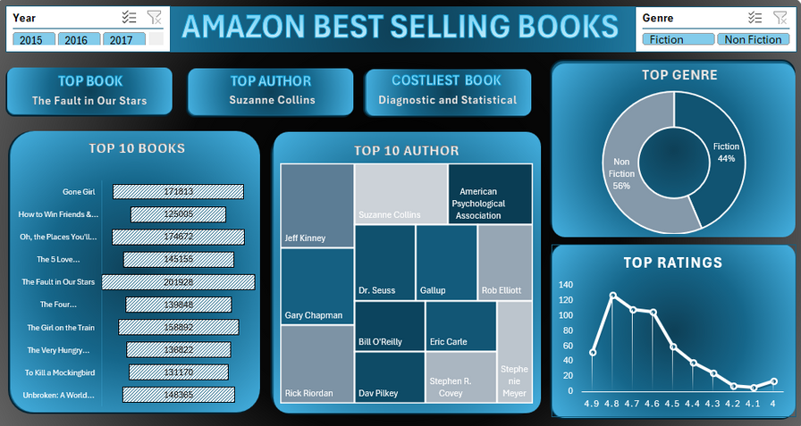
Excel Dashboard
Purpose: Provide a simple yet effective platform to analyze Amazon’s Top-Selling Books, using Excel’s built-in tools to transform raw data into clear and accessible insights.
Modules: Sales Overview | Ratings & Reviews | Genre Distribution | Top 10 Books & Authors | Price vs Sales | Ratings Trends
Features: Pivot tables, slicers, conditional formatting, and dynamic charts that allow users to filter and summarize data by year, genre, author, or price range without complex technical knowledge.
Outcome: Delivers a lightweight, user-friendly dashboard for quick reporting and offline analysis, enabling stakeholders to interpret book sales performance and trends efficiently.

Slide 11
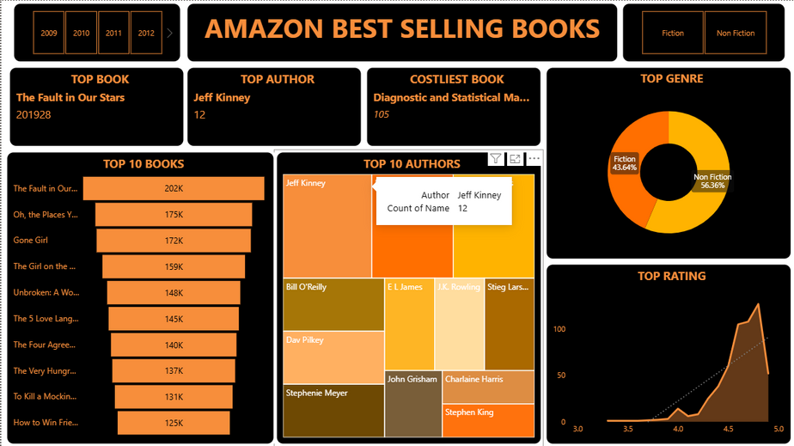
Power BI Dashboard
Purpose: Provide an interactive and visually rich platform for exploring Amazon’s Top-Selling Books, enabling users to quickly uncover patterns and relationships through intuitive dashboards.
Modules: Sales Overview | Ratings & Reviews | Genre Popularity | Top 10 Books & Authors | Price vs Sales | Ratings Distribution
Features: Interactive slicers, filters, drill-down capabilities, and dynamic charts that allow users to analyze data by author, genre, rating range, or price segment in real time.
Outcome: Transforms raw book sales data into actionable insights, supporting informed decision-making and strategic planning for publishers, marketers, and analysts.

Slide 12
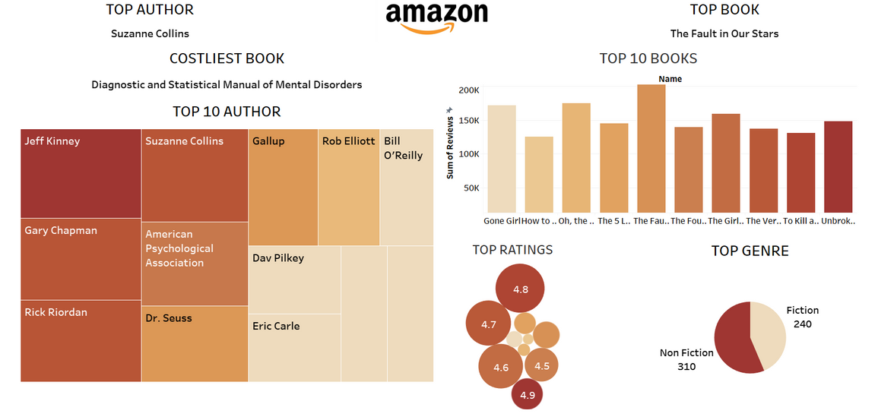
Tableau Dashboard
Purpose: Provide a visually engaging and highly interactive dashboard in Tableau to explore Amazon’s Top-Selling Books, simplifying complex relationships into clear and intuitive visual insights.
Modules: Sales Overview | Ratings & Reviews | Genre Popularity | Top 10 Books & Authors | Price vs Sales | Ratings Distribution
Features: Drag-and-drop visualizations, interactive filters, and parameter controls that allow users to dynamically explore data by author, genre, rating range, or price segment with ease.
Outcome: Combines Tableau’s strength in data storytelling with analytical depth, enabling both quick exploratory insights and detailed analysis for publishers, marketers, and analysts.

Slide 13
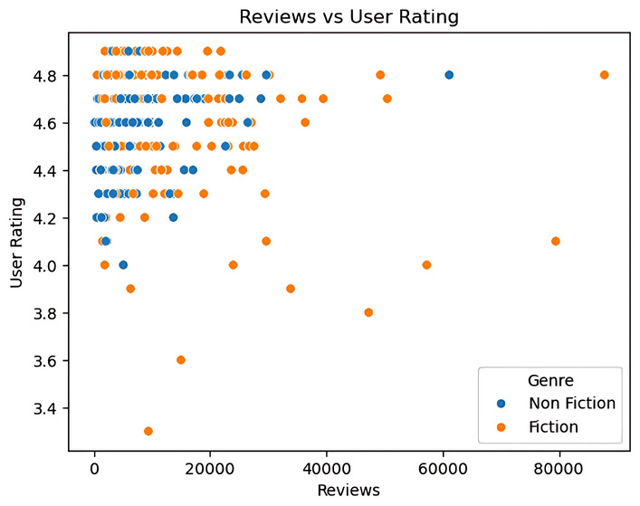

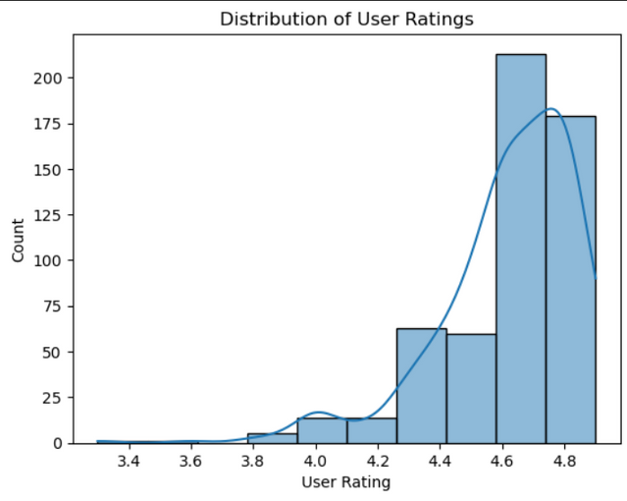
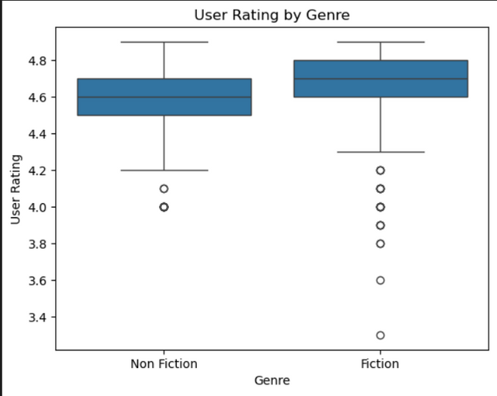
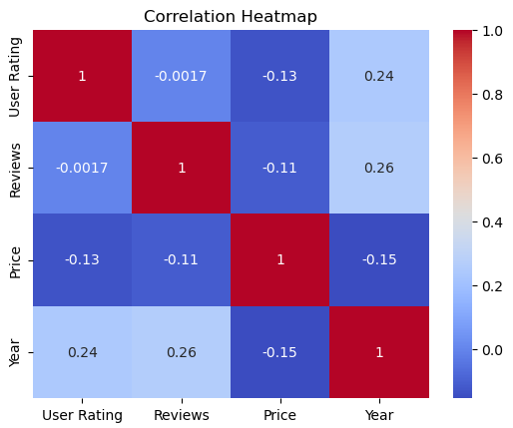
Python Data Analysis – Overview
Histplot – Illustrates the distribution of book prices and user ratings within Amazon’s Top 50 Bestsellers, revealing concentrated price ranges and consistently high ratings above 4.5.
Boxplot – Highlights differences in price variation between Fiction and Non-Fiction titles, showing wider spreads and occasional high-price outliers in the Non-Fiction category.
Heatmap – Visualizes the correlation between key metrics such as Price, Ratings, and Review Count, uncovering subtle relationships and disproving assumptions that higher ratings always align with higher prices.
Scatterplot – Maps Price against Ratings and Reviews, exposing patterns such as affordable titles achieving exceptional ratings and heavily reviewed books spanning various price points.

Slide 14
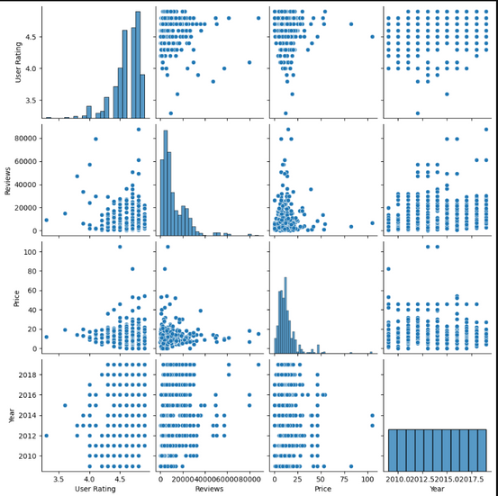
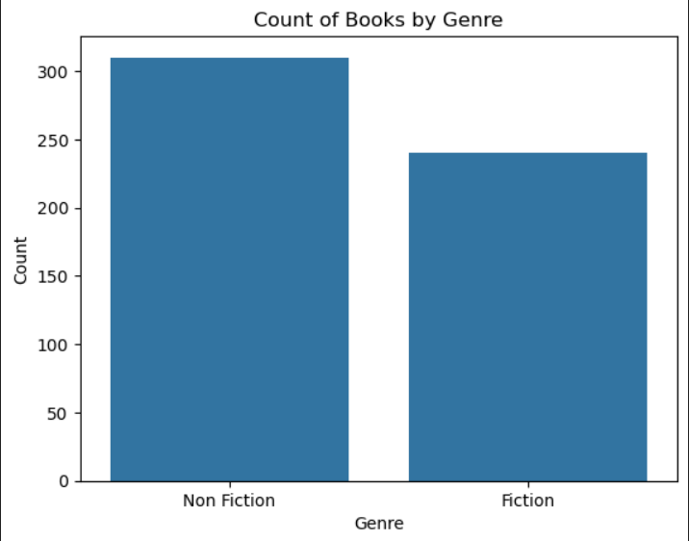
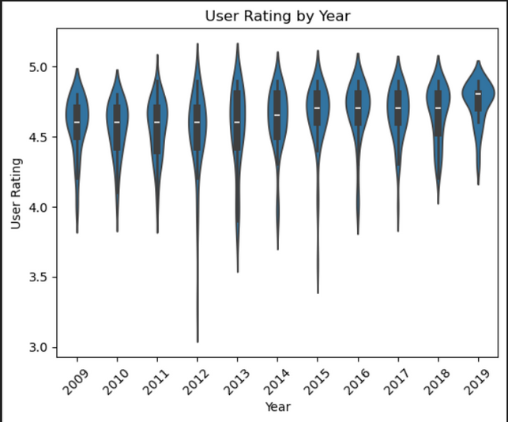
Python Data Analysis – Overview
Pair Plot – Provides a comprehensive visualization of relationships among numerical variables (Price, Ratings, Review Count), allowing identification of patterns, clusters, and potential outliers across multiple pairwise comparisons.
Violin Plot – Combines distribution and summary statistics to compare Price distributions between Fiction and Non-Fiction categories, clearly showing differences in spread, density, and median values.
Count Plot – Displays the frequency of books across categorical variables (e.g., Genre, Author), making it easy to identify dominant categories and compare their relative contributions within the dataset.

Slide 15

Model Training & Classification – Process
Purpose:
Develop and evaluate machine learning classification models to predict the genre or sales performance category of Amazon’s Top-Selling Books using key dataset attributes.
Workflow:
Data Cleaning – Removed duplicate book entries, dropped irrelevant columns, and handled missing values using statistical imputation or record removal.
Data Preprocessing – Standardized text formats (e.g., author names, genres) and corrected inconsistencies in categorical and numerical data.
Encoding – Converted categorical fields such as Genre and Author into numeric form using Label Encoding and One-Hot Encoding.
Feature Scaling – Applied StandardScaler to normalize numerical features like Price, Ratings, and Review Count for better model performance.
Input/Output Split –
X: Price, Ratings, Review Count, Genre indicators
Y: Target classification label (e.g., Fiction/Non-Fiction or sales category)
Train-Test Split – Divided the dataset in an 80:20 ratio to train models on most data while keeping a portion for unbiased evaluation.

Slide 16
Data Cleaning
Data Preprocessing
Encoding
Input/Output Split
Feature Scaling
Train-Test Split
Model Training

Slide 17
Model Training & Classification – Models & Evaluation
Models Implemented (Amazon Top 50 Books Dataset):
Logistic Regression – Used as a baseline model, providing a simple and interpretable approach for predicting book genres or sales categories.
Gaussian Naive Bayes – Offered fast classification, performing effectively on the dataset by leveraging probabilistic assumptions of feature independence.
K-Nearest Neighbors (KNN) – Predicted outcomes by measuring similarity between books based on attributes like price, ratings, and review counts.
Support Vector Machine (SVM) – Applied to model both linear and non-linear relationships, effectively distinguishing book performance categories.
Evaluation Metrics:
Accuracy – Measured the overall proportion of correctly classified predictions.
Precision – Evaluated the proportion of true positives among all predicted positives, highlighting the model’s ability to avoid false positives.
Recall – Assessed the proportion of true positives correctly identified, emphasizing the model’s ability to capture actual positives.
F1 Score – Provided a balanced metric combining Precision and Recall to account for class imbalance.
Confusion Matrix – Visualized correct vs. misclassified predictions across categories for detailed performance analysis.

Slide 18
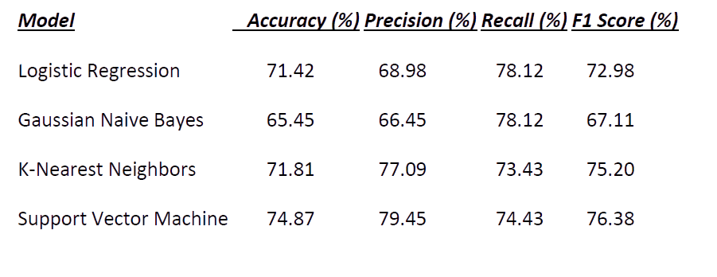
Result:

Slide 19
Conclusion
The analysis of Amazon’s Top-Selling Books highlights that Non-Fiction titles dominate bestseller rankings, reflecting reader demand for informative content. High ratings and extensive review counts significantly influence buyer decisions, while affordable pricing under $105 makes books more accessible. Repeated appearances of certain authors demonstrate the importance of loyal readership and consistent publishing. These insights provide valuable guidance for publishers and authors, enabling them to refine pricing strategies, boost reader engagement, and strengthen brand presence to achieve sustained bestseller success.

Slide 20
Thank You

